Slide 1
A little “bit” about the ADC
https://homestudiomagic.com/what-does-an-analog-to-digital-converter-do/

Slide 2
Analog to Digital Converter (ADC)
Δv
Δt
Image credit: https://www.doeeet.com/content/eee-components/actives/analog-to-digital-converters-the-resolution-dilemma/

Slide 3
Analog to Digital Converters (ADCs)
int sensorVal = analogRead(A0);
float V = sensorVal * (3.3/1023);
Image credit: https://learn.adafruit.com/adafruit-feather-32u4-bluefruit-le

Slide 4
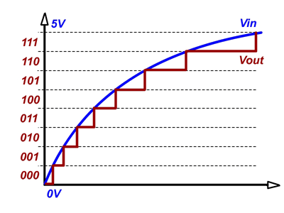
Analog-to-Digital Converter (ADC)
2-bit ADC
3-bit ADC
3.3 V
3.3 V
Least Significant Bit (LSB)
= ADC resolution
Resolution = 3.3V/4 LSB = 0.825 V/bit
Resolution = 3.3V/8 LSB = 0.4125 V/bit
Images adapted from: https://pixinfo.com/cikkek/alapfokon-analog-digitalis-atalakitok/

Slide 5
Adafruit Feather 32u4 BLE
10-bit ADC
3.3 V logic level
ADC resolution = ?
Assume you are recording an input single that consists of a 10 mV amplitude sine wave oscillating at ~2 Hz at a sampling rate of f_{s} = 40 Hz.
How many ADC bits does this input signal cover peak-to-peak?
Sketch the waveform recorded by the Feather
Now imagine we amplify the signal before converting it to digital. The amplified signal amplitude is 1V. Sketch the recorded waveform. Compare and contrast to the 10 mV case.

Slide 6
Successive Approximation Register (SAR)
1 step at a time
Electronics inside
Image credit: https://www.maximintegrated.com/en/app-notes/index.mvp/id/1080

Slide 7
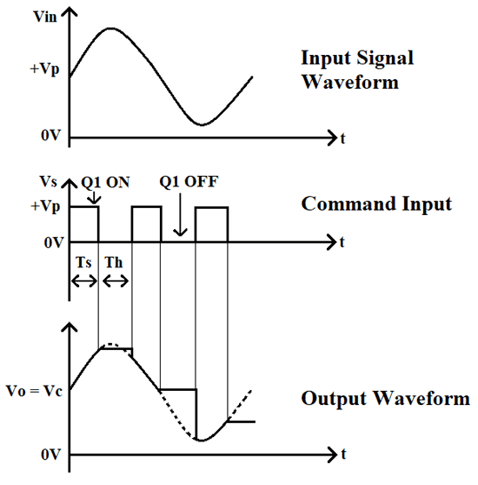
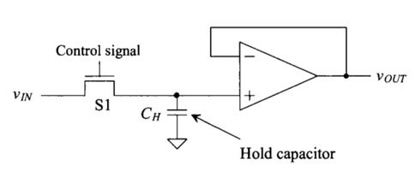
Sample and Hold
https://circuitdigest.com/electronic-circuits/sample-and-hold-circuit-op-amp

Slide 8
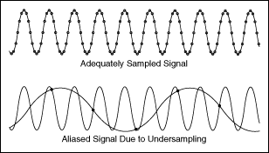
Sampling rate

Slide 9
Nyquist/Shannon Sampling Theorem
A continuous-time signal can be completely recovered from its samples iff the sampling rate (fs) is greater than twice the maximum frequency (f) present in the signal:
$$f_{s}>2f$$
http://www.dgp.toronto.edu/~ah/csc418/fall_2000/notes/sampling.html

Slide 10
Sampling Rate 10x Rule of THumb
For good signal reconstruction of a signal oscillating with frequency f, the sampling rate f_{s} should be about 10 times higher:
$$f_{s}≥10f$$
Bare minimum
Much better!
Image credit: NI.com

Slide 11
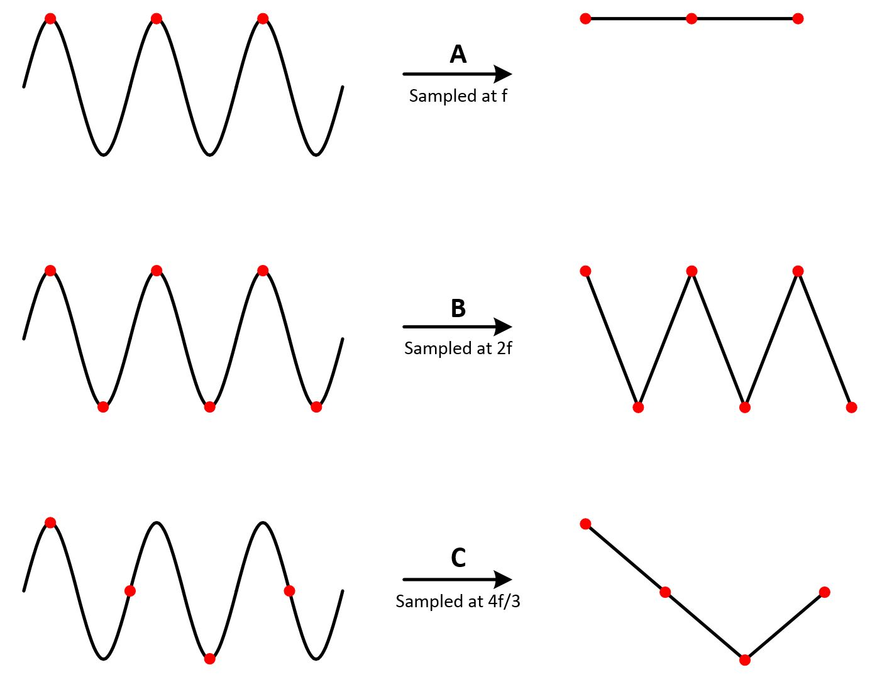
Aliasing: What Happens When we don’t sample fast enough
1s
Image credit: https://www.programmersought.com/article/575268815/

Slide 12
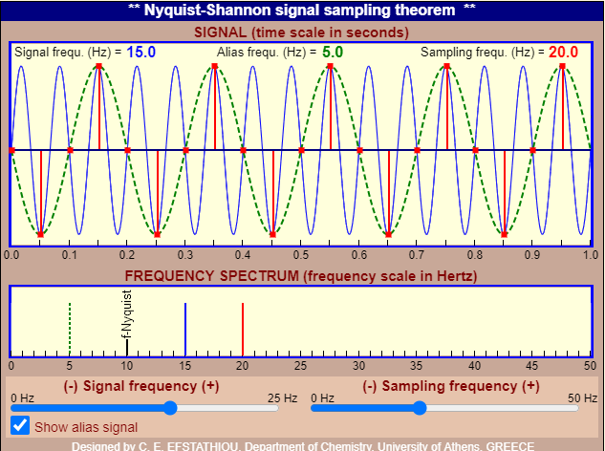
Aliasing
Things aren’t what they seem!
Nyquist/Shannon sampling criterion not met
Example: signal is oscillating at 15 Hz. We record the signal at with sampling frequency 20 Hz (sampling period = 1/20 s). The signal we record “looks like” a 5 Hz oscillation!
http://195.134.76.37/applets/AppletNyquist/Appl_Nyquist2.html

Slide 13
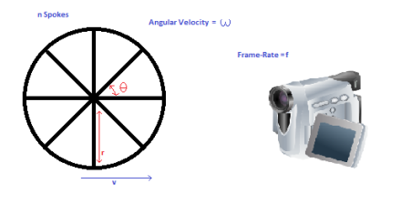
ALIASING Video
Happens with video cameras too.
Sampling rate = frames per second
Image credit: https://maycontainmaths.wordpress.com/2015/02/22/the-wagon-wheel-effect/

Slide 14
Practical stuff: How to set the sampling period (frequency)
Option 1: delay()
Option 2: interrupts
Do stuff
(analogRead)
Wait
(delay)

Slide 15
Daily Routine….interrupted
Interrupt example
Always listening for: phone line reserved solely for NinjaNation producers rings
ISR: Then Instantly stop everything and scream for joy!
Then resume the daily routine

Slide 16
Timer interrupts
Set the timer to go off every 10 min
When timer goes off, drop everything and do 5 jumping jacks
Resume daily life

Slide 17
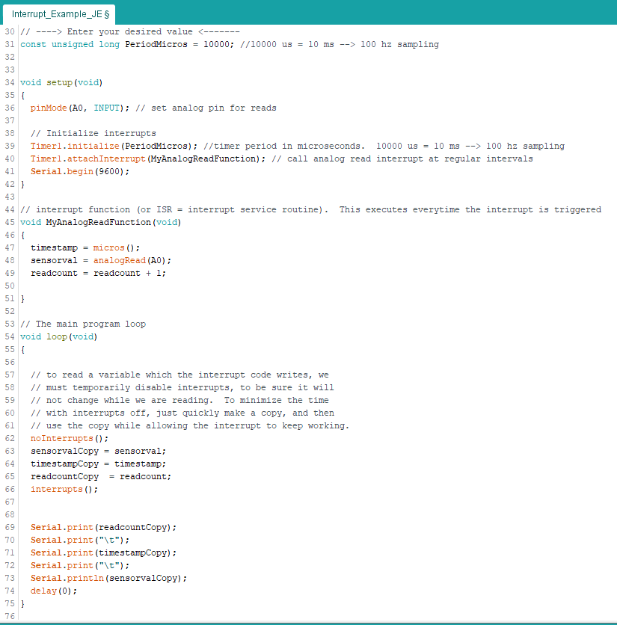
Sample Number
Timestamp (μs)

