Slide 1

Flash Memory
…and a tour through FETs

Slide 2
Conceptual Roadmap
PN junction
Connect a drain (D), Source (S), Gate(G)
JFET
Insert thin oxide layer between gate contact and doped substrate
MOSFET
Add a floating gate
Flash Cell
Put a bunch together in NAND or NOR configuration
Flash Blocks
Out pops an SD card
or MCU flash memory!
Modern Devices

Slide 3
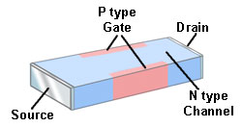
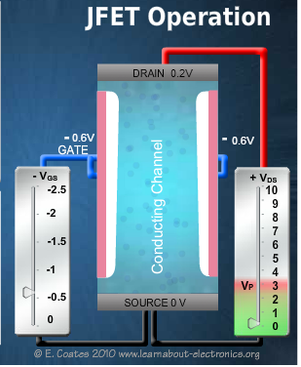
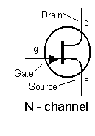
Junction Field Effect Transistor
Notes:
Always operated in reverse bias
This means very low control current compared to BJT and uber high input resistance.

Slide 4
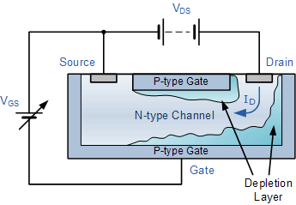
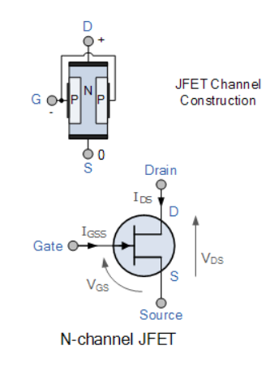
JFETs
Image credit: https://www.electronics-tutorials.ws/transistor/tran_5.html

Slide 5
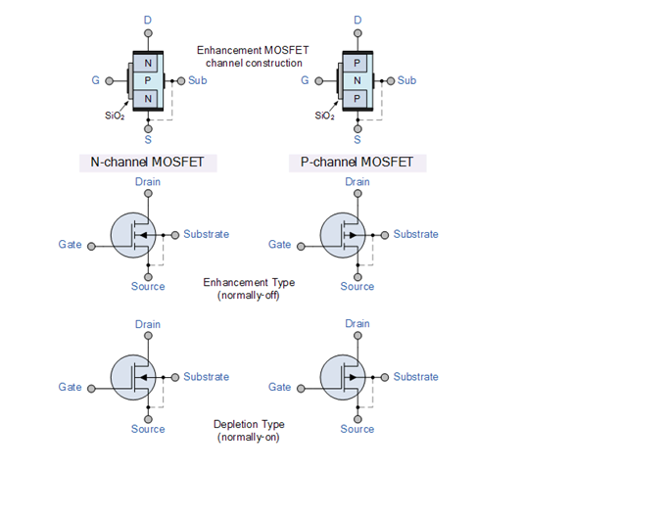

What’s a MOSFET?
Notes:
LearnEngineering video is a brilliant 7 min intro to MOSFETs

Slide 6
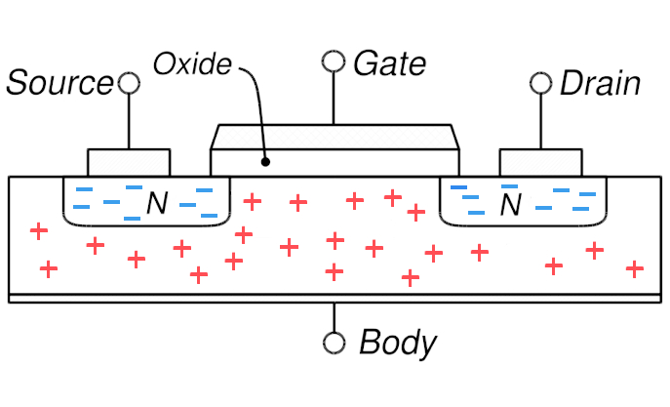
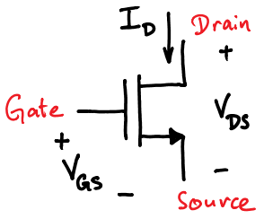
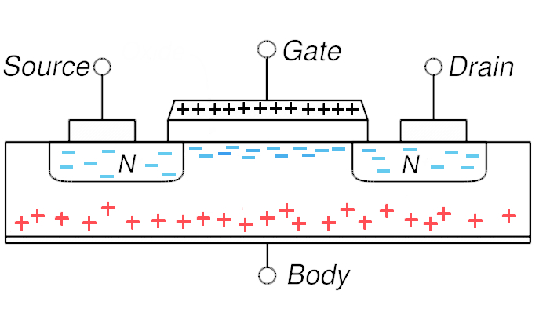
Metal Oxide Insulator: Feel the Force
n-Channel Enhancement Mode MOSFET
Image credit: https://courses.engr.illinois.edu/ece110/sp2019/content/courseNotes/files/?MOSFETs#FET-NSM

Slide 7
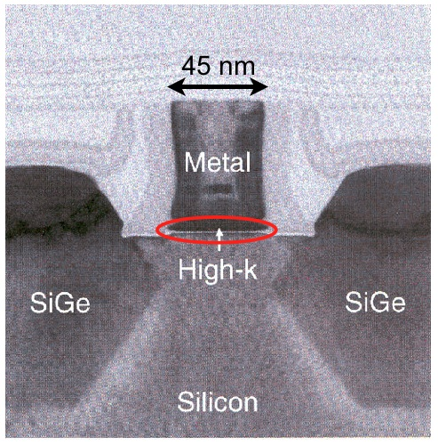
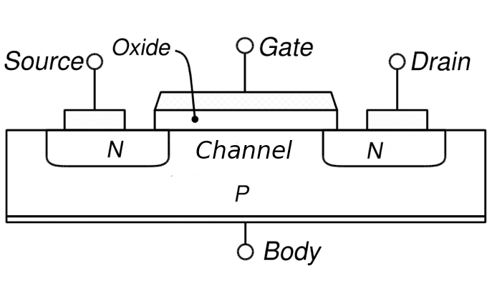
Actual MOSFET Devices
Single MOSFET on Intel chip
Enhancement MOSFET
Notes:
Video from Microchip Electronics covers basic operation principle of MOSFET/flash memory

Slide 8
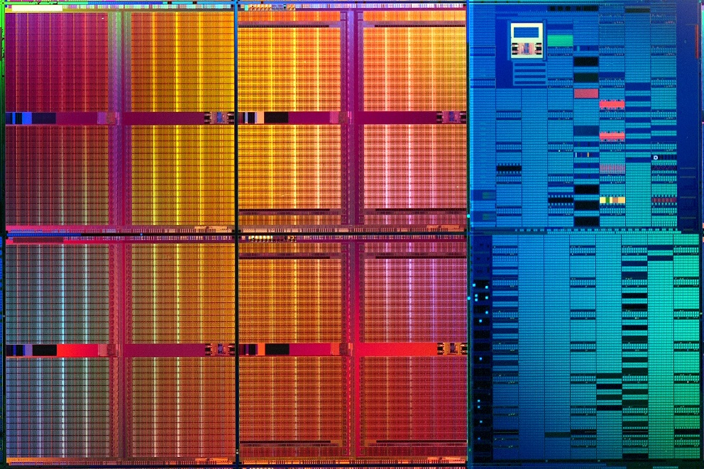
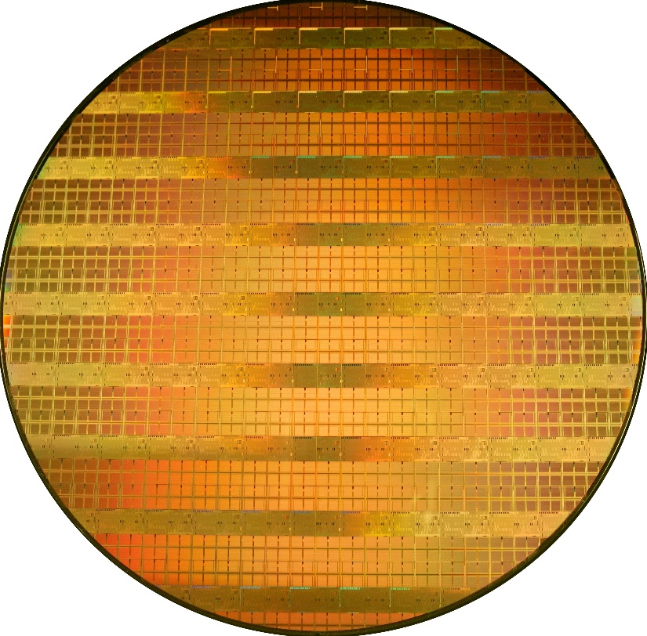
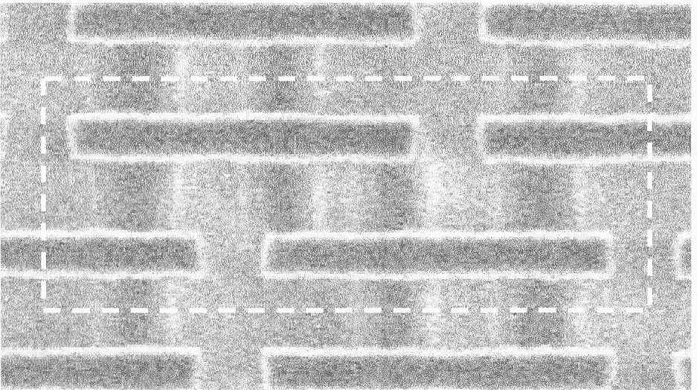
Nanofab Lab
Intel 300 mm wafer, 45 nm technology (Intel 2006)
154 Mbit SRAM cell (top)
Six transistor SRAM cell (bottom)

Slide 9
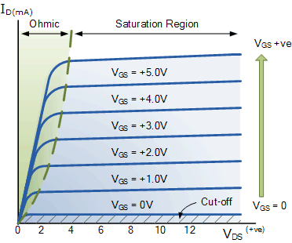

MOSFET Operational Curve
$$I_{D}=k{(V_{GS} − V_{TH} )}^{2}$$
Changing this the key to Flash memory!

Slide 10

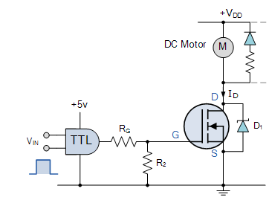
MOSFET Digital Switch: Motor Control
Circuit component
Motor Control Circuit
Notes:
Very low channel resistance means very little power dissipated (wasted) in the MOSFET itself. Important for high current apps such as motor control

Slide 11
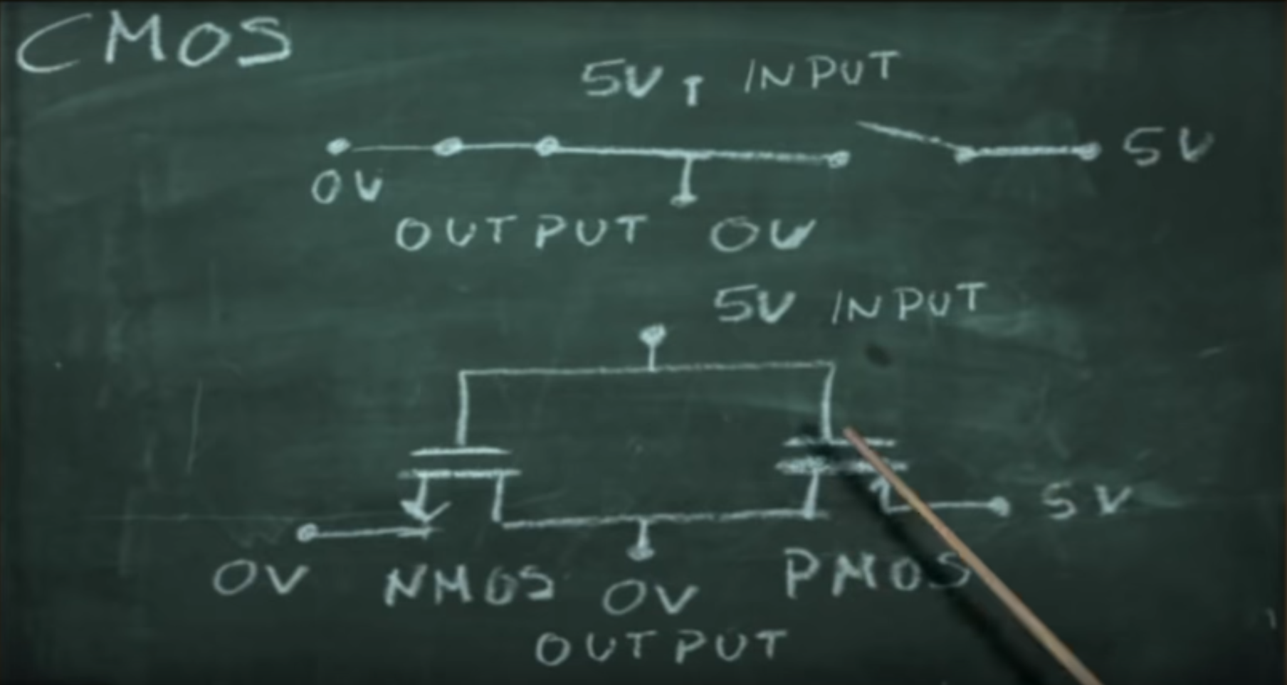
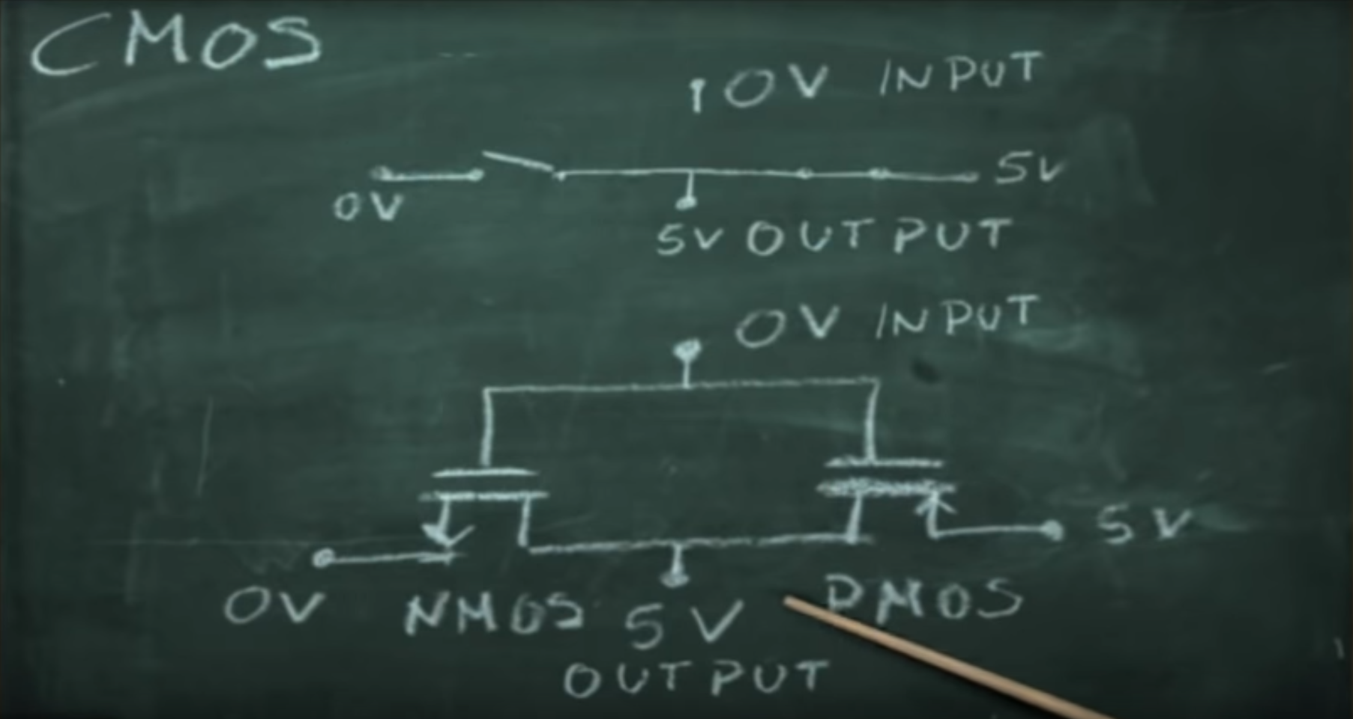
CMOS = Complementary MOS
5V in→ 0V out
0V in → 5V out
Image credit: fmgomezcampos on youtube

Slide 12
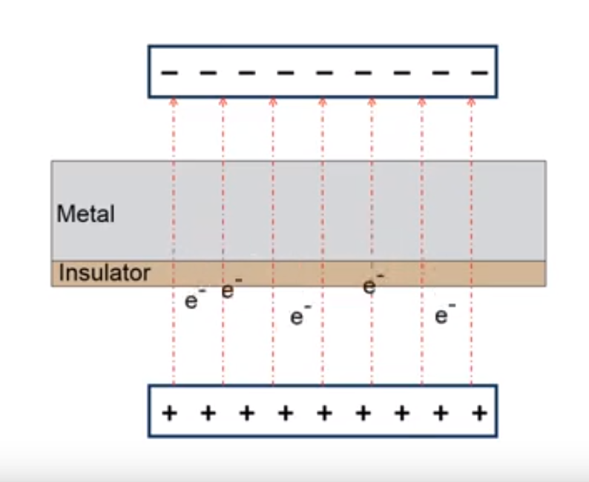
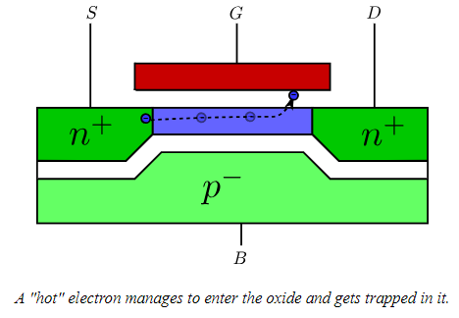
Quantum Leap:
Hot Carrier Injection
Fowler-Nordheim Tunneling
If gate (G) is positive, electron is pulled upwards
http://www.onmyphd.com/?p=mosfet.short.channel.effects
Microchip Technology Tutorials

Slide 13

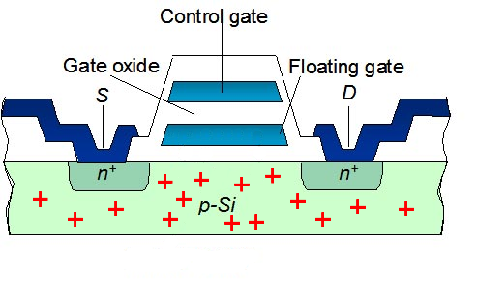
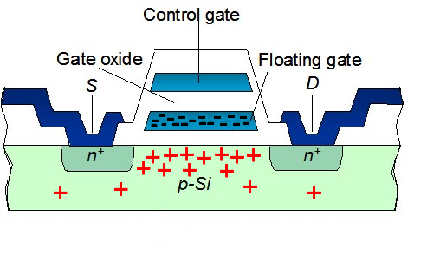
Floating Gate MOSFET = Flash
+++++
Assume:
V_{DS} =V_{D} - V_{S} =+7V
What happens if?:
V_{GS} =V_{G} – V_{S=} +10 V
Then what happens?:
to ‘jailed’ electrons if
V_{GS} is set to 0V?
Notes:
Helpful video from microchip to explain the basics of flash linked to main photo. Another helpful companion video here: https://www.youtube.com/watch?v=2QyKVU1IRZg

Slide 14
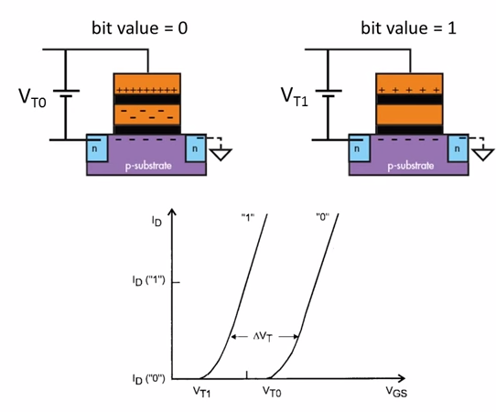
Reading Memory State
Change in Threshold Voltage due to Screening Effect of Floating Gate
Read mode: Apply intermediate voltage, check whether current is flowing or not
Notes:
Excellent 17 min introduction to Flash memory operation

Slide 15
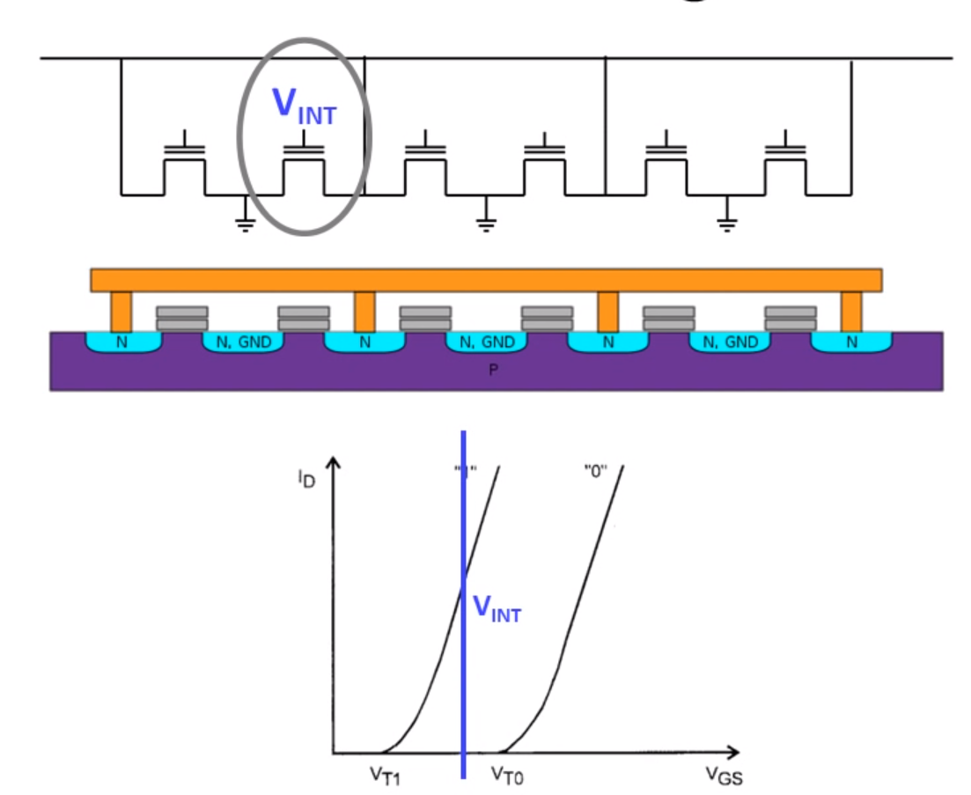
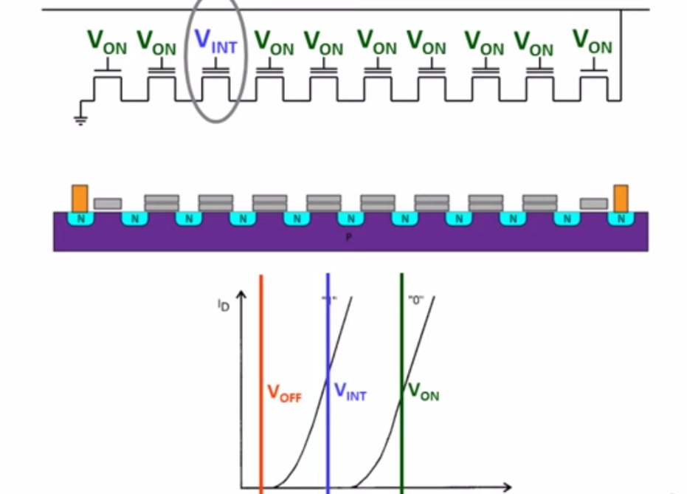
Reading
NOR Flash
NAND flash

Slide 16

Moving electrons: Flash Erase and Writes
Sets all bits back to 1
High negative voltage applied to control gate forces electrons out of floating gate back into p substrate (if they are there to begin with)
Or can apply high positive voltage and electrons get pulled out toward control cate

Slide 17
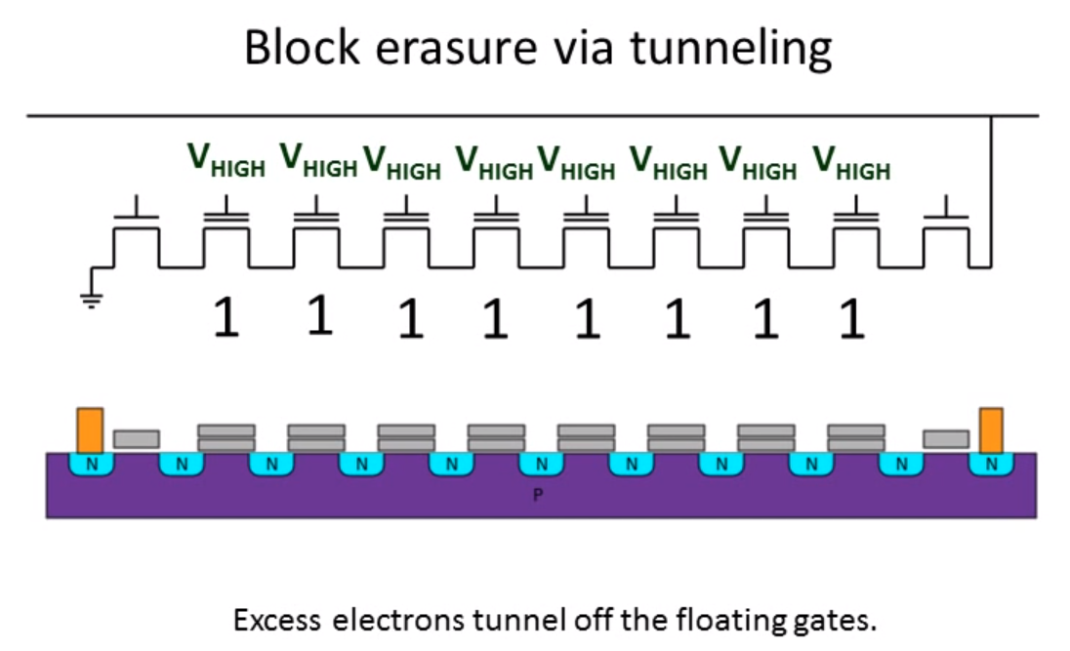
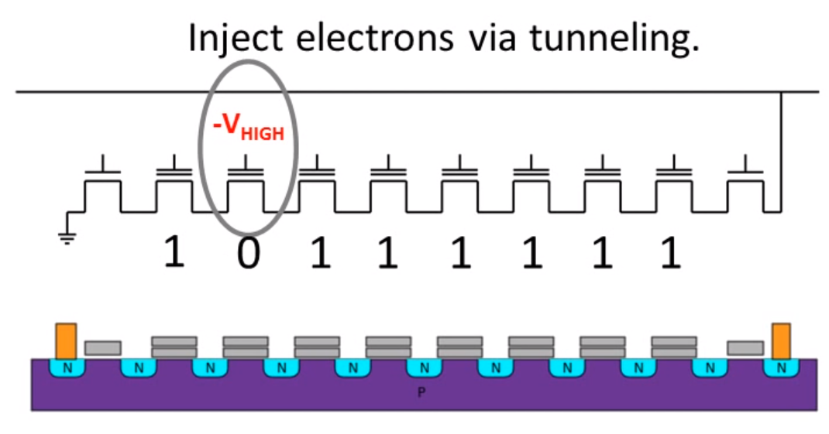
Flash Erase and Write (NAND)
1
2

Slide 18
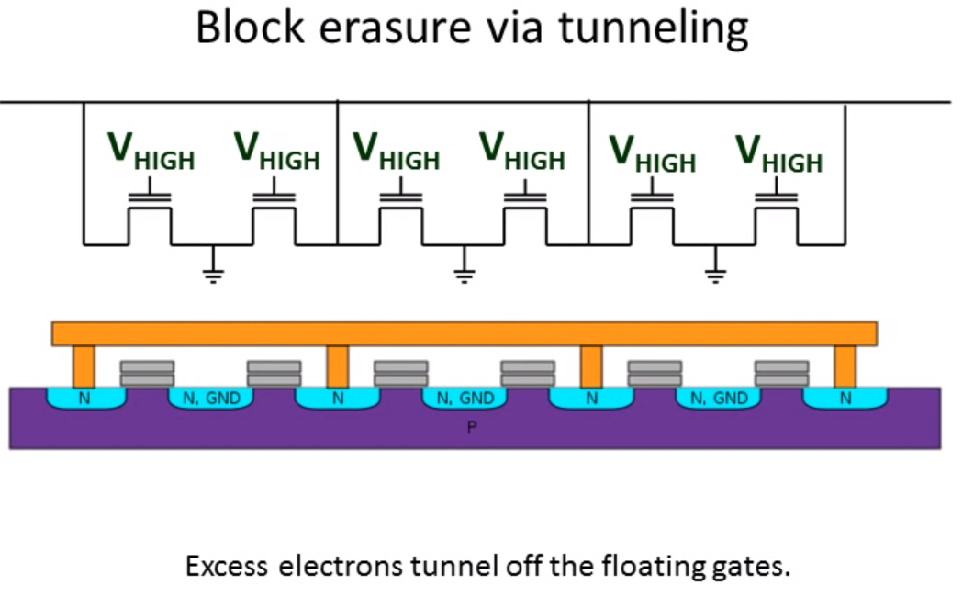
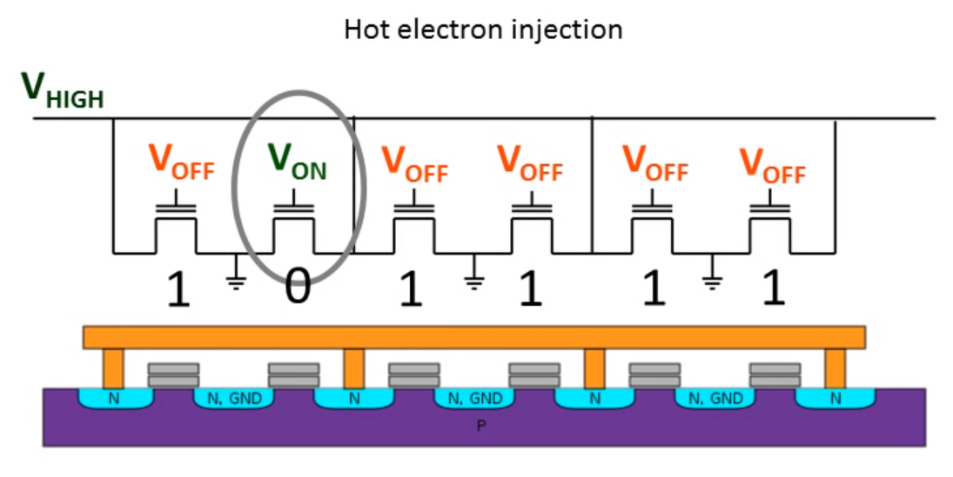
Flash Erase & Write (NOR)
1
2

Slide 19


Voila – Non-volatile flash memory stick and SD card
Limitations: Erase cycles are damaging to the MOSFET structures
Partial solution: Wear leveling; newer devices use lower voltages

Slide 20
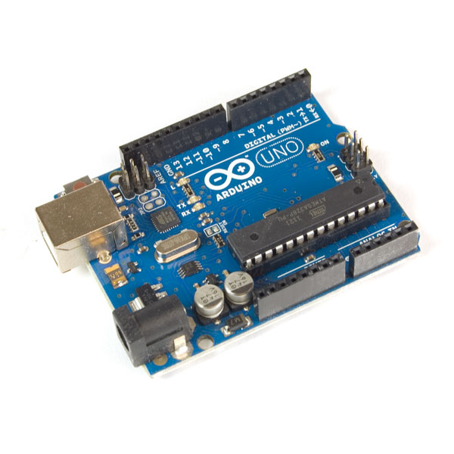
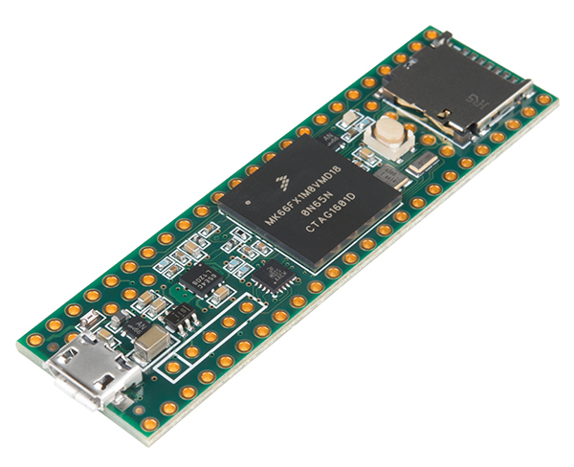
Microcontrollers & Memory
Arduino Uno R3
Teensy 3.6
 | Arduino Uno | Teensy 3.6
Flash | 32 kB | 1 MB = 1000 kB
RAM | 2 kB | 256 kB

Slide 21


Flash Usage
Reserve memory space for 3 ints
Write the initial value into those blocks of memory
Print some stuff to Serial
Go back and get those 3 ints
Solve the quadratic equation doing:
Compute $\sqrt{b^{2} −4ac}$
Store the result in a new variable called D.
Figure out if D is =0, + or –
Compute the roots using quadratic formula
Print those results to Serial
Check if user wants to update the coefficients
RAM needed to actually do all of these tasks!

Slide 22
RAM usage
Stack: space for stuff the MCU knows is coming – defined in functions and interrupts
Heap: space for stuff that the MCU doesn’t know is coming (dynamic allocation)
Figure 1. SRAM memory usage summary. Image credit: Adafruit.com

Slide 23
Citations/Image Sources
http://www.learnabout-electronics.org/fet_01.php (JFETs)
https://volga.eng.yale.edu/teaching-resources/flash-drives/methods-and-materials https://www.electronics-tutorials.ws/transistor/tran_5.html
https://www.electronics-tutorials.ws/transistor/tran_6.html (MOSFT operation)
http://www.electronics-tutorials.ws/transistor/tran_7.html (MOSFET motor control)
http://www.engadget.com/2011/10/31/engadget-primed-ssds-and-you/
https://www.youtube.com/watch?v=msi5GDz9JIw (hyperscience youtube channel – reading flash contents)
https://www.youtube.com/watch?time_continue=854&v=s7JLXs5es7I (great summary of Flash memory construction and operation)

