Slide 1
Operational Amplifiers
Golden Rules

Slide 2


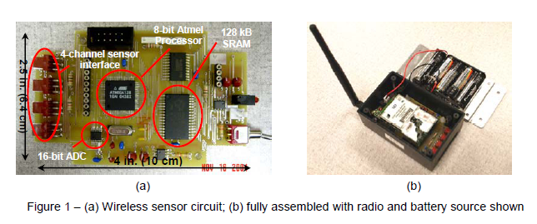
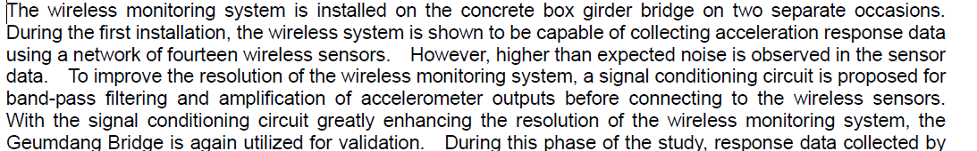
BPF + Op-amp: Applications
Proceedings of the 24th International Modal Analysis Conference (IMAC XXIV), St. Louis, MO, January 30 - February 2, 2006
http://www.wang.ce.gatech.edu/publication_pdfs/Conference_Papers/IMACXXIVLynch.pdf

Slide 3
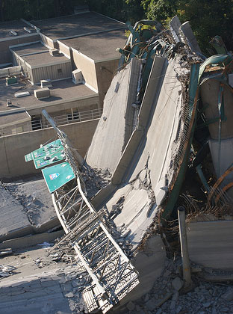

What happens when we don’t monitor?
Minneapolis, August 2007

Slide 4
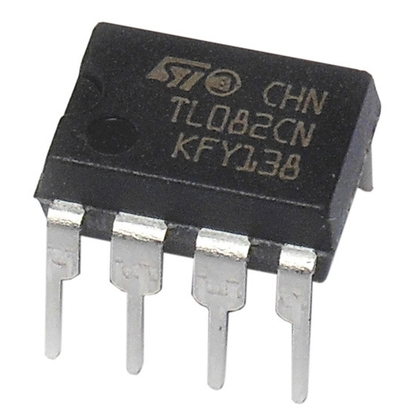
Data Sheets

Slide 5
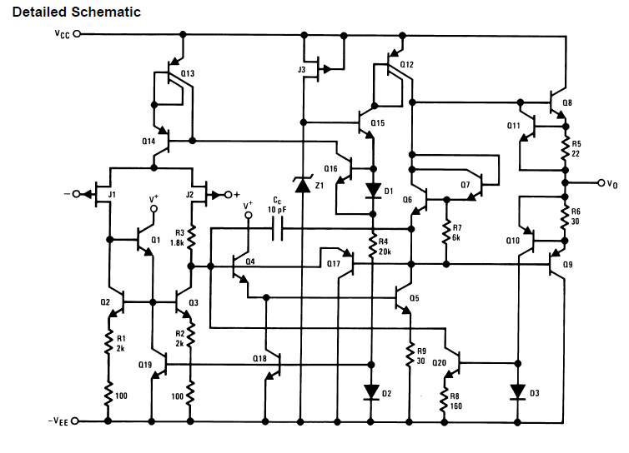
What’s in the box?
(Hint: Lots of transistors)

Slide 6
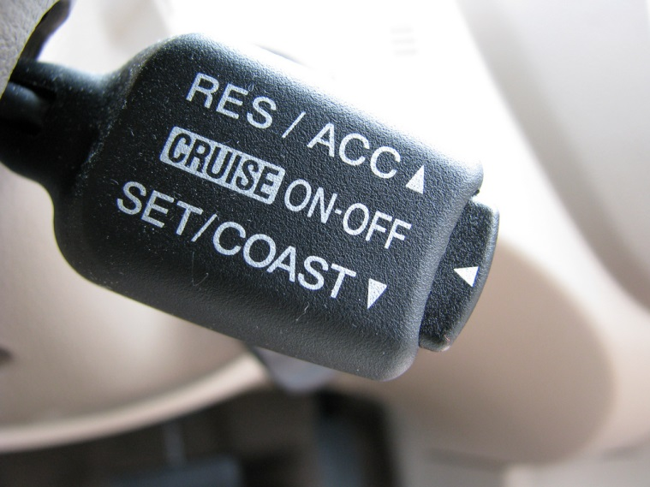
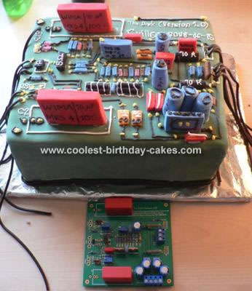
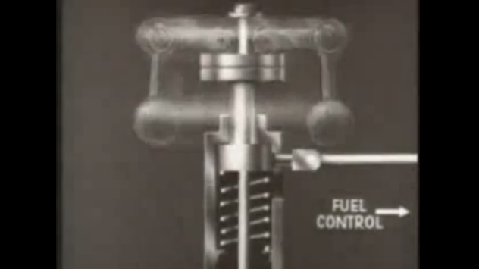
Negative Feedback
Notes:
http://www.youtube.com/watch?v=CXogtrK4g5s. Fwd to 5:31 min

Slide 7
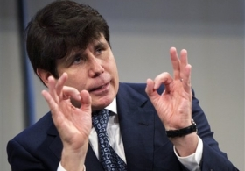
The Golden Rules
IF connected in negative feedback, an op-amp circuit obeys the following 2 golden rules:
Golden Rule #1:
  v₊ = v₋
Golden Rule #2
  i₊ = i₋ = 0
http://blogs.sj-r.com/offtheclock/index.php/archives/2166

Slide 8

Given:
+/- V_{cc} = +/- 15 V
R_{f} = 4 kΩ, R_{i} = 1 kΩ, R₃ = 800 Ω
Solve:
For the input signal shown below (1V amplitude cosine), sketch v_{out}(t)
Non-inverting amplifier, G = (1+R_{f}/R_{i}) = 5;

Slide 9
Given:
+/- V_{cc} = +/- 15 V
R_{f} = 4 kΩ, R_{i} = 1 kΩ, R₃ = 800 Ω
Solve:
For the input signal shown below (5V amplitude cosine), sketch v_{out}(t)
Non-inverting amplifier, G = (1+R_{f}/R_{i}) = 5; Saturation occurs at power supply limits!

Slide 10
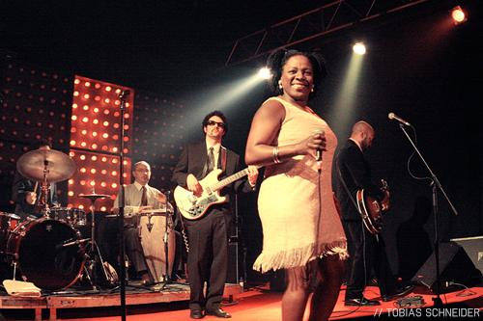
Sharon Jones and the Dap Kings:
Spanning the audible spectrum low, mid, and high
http://jazzcapital.net/artists/sharon-jones-and-the-dap-kings.php

Slide 11
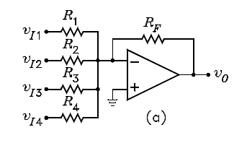
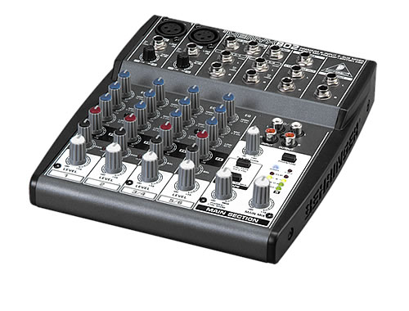

Summer (Inverting)
Audio mixer
Weights for weighted sum

Slide 12
Sharon Jones of the Dap Kings just messaged: “Circuits class! Silly trombone player got his slobber all over our mixer last night. We need help right away, b/c we have a hot concert tonight. Any chance you could build the band some an audio mixer? We need vocals, electric guitar and drums all on mixed a single track. Also, we want to be able to independently control the relative volume (gain) of each instrument between the range of 1/10 (very muted) and 10 (very loud). Please, help us!.”

Slide 13

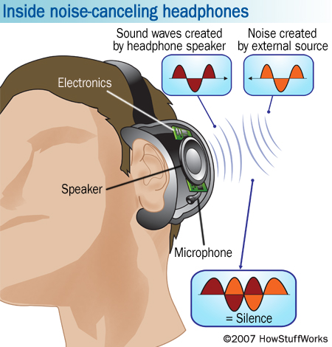
Noise Cancelling Headphones
Design an op-amp based circuit that acts as a noise canceling headphone. Use op-amps in summing and inverting configs.
http://electronics.howstuffworks.com/gadgets/audio-music/noise-canceling-headphone3.htm

Slide 14
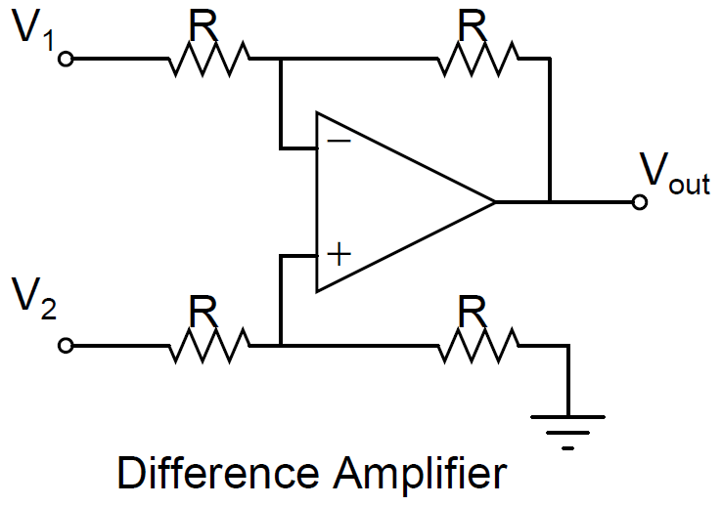
Difference Amplifier
Show that this op-amp outputs the difference between 2 inputs:
V_{out} = V₂ – V₁

Slide 15
Instrumentation Amp
(Better version of difference amp)
40k
10k
10k
40k
a
b
c
INA 126
V_{out} = G(V⁺_{in} – V⁻_{in}) + V_{REF}
G = 5 + 80kΩ/R_{G} [voltage gain]
R_{G} = gain setting resistor
V_{REF} = offset voltage (‘bias voltage’)
Figure credit: TI INA 126 datasheet:
http://www.ti.com/lit/ds/symlink/ina126.pdf

Slide 16
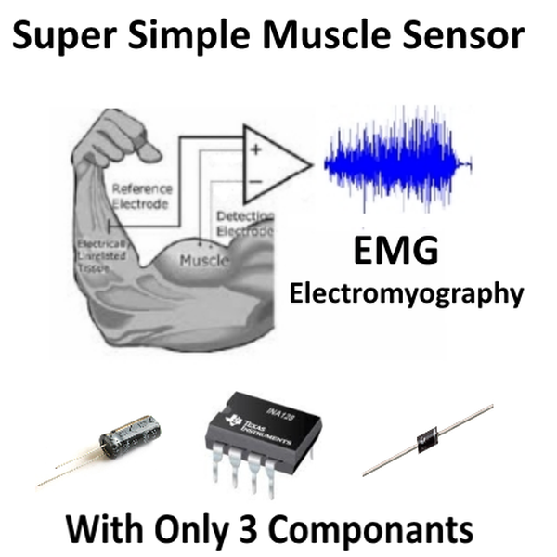

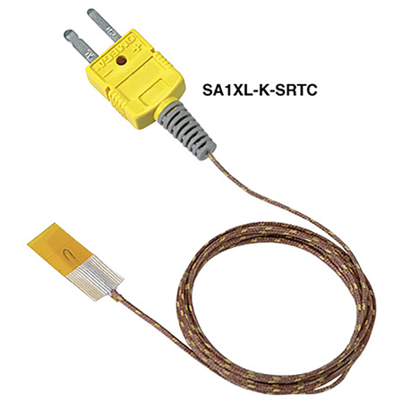
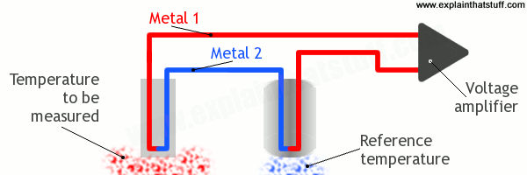

Why measure a difference?
Neural Prosthetic Hands
Temperature Measurement
Image credits: i-limb.com, hackaday,com, wlu.edu, omega.com, explainthatstuff.com

Slide 17
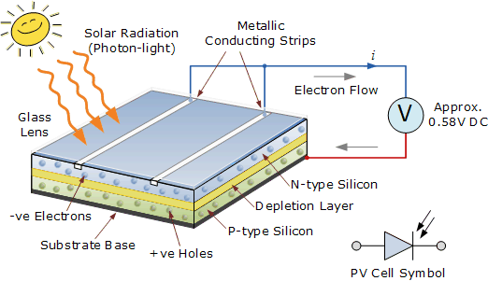

Still more applications
Photovoltaic solar cells produce a variable output DC current that is proportional to their size and the amount of solar radiation falling upon the silicon wafer.
http://www.alternative-energy-tutorials.com/solar-power/photovoltaics.html

Slide 18

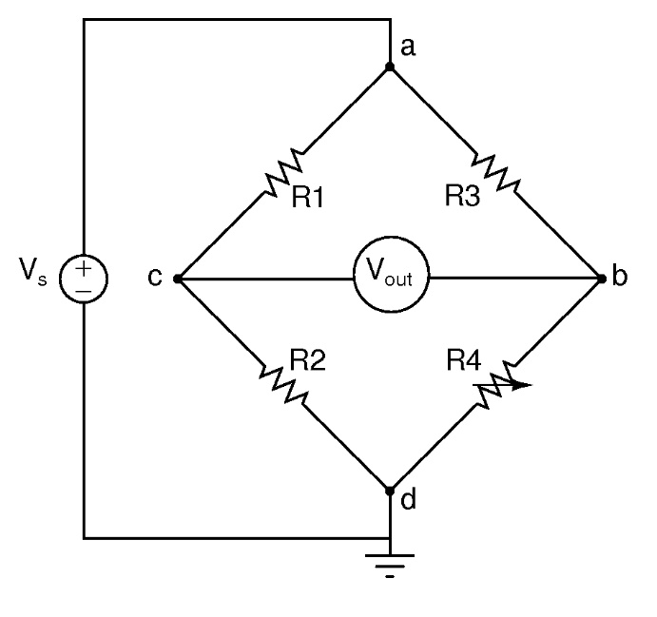
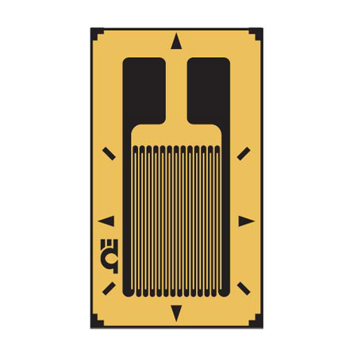
Structural Health Monitoring: Measuring Mechanical Deformation

Slide 19
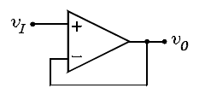
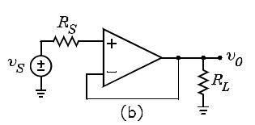
Buffer (“Voltage Follower”)
Use it anytime you want to get a voltage measurement without disturbing the circuit you are trying to measure
Isolates high R_{s} from low R_{L}
Notes:
https://www.youtube.com/watch?feature=player_embedded&v=Ie0ZOlUM7e4

Slide 20
(A) Inverting amp
(B) Summer
(C) Non-inverting amp
(D) Buffer
(E) Comparator

Slide 21
Op-amps: Part II
Instrumentation Amp & Active Filters

Slide 22
Instrumenting Prosthetic Hand: The ElectroMyoGram
http://www.touchbionics.com/products/active-prostheses/i-limb-ultra/
Notes:
https://www.youtube.com/watch?v=_qUPnnROxvY

Slide 23
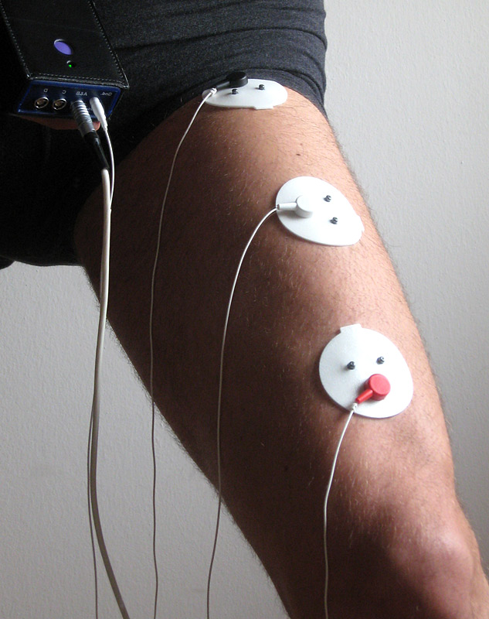
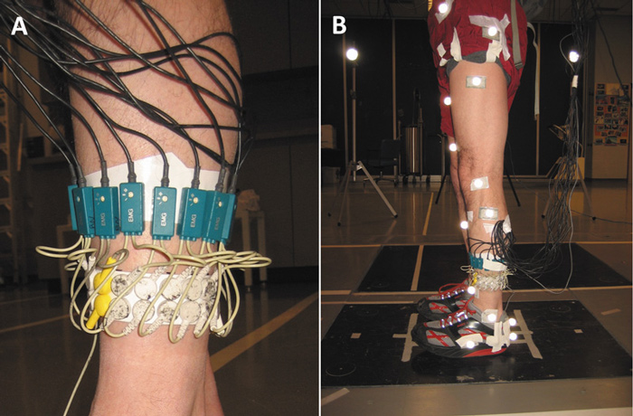
How to measure the EMG
Skin electrodes
Filters and Amplifiers
http://www.vibrationtrainingdevice.com/VG-Evolution-I-Vibrogym.htm
http://lowerextremityreview.com/article/unstable-shoe-designs-functional-implications

Slide 24
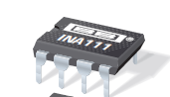
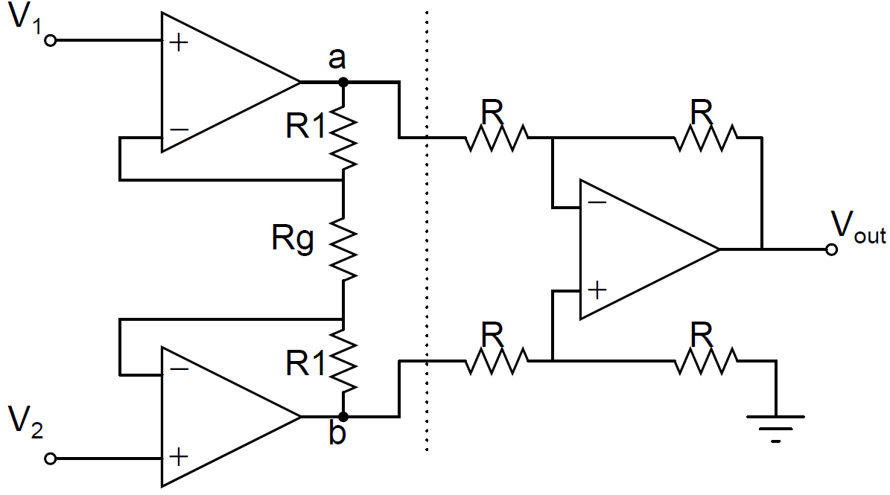
Instrumentation Amplifier: What’s Inside the Box
Difference Amplifier

Slide 25
The ElectroMyoGram (EMG)
Image from Intan Technologies RHD2000 series datasheet (intantech.com)

Slide 26
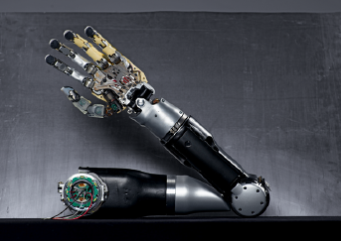
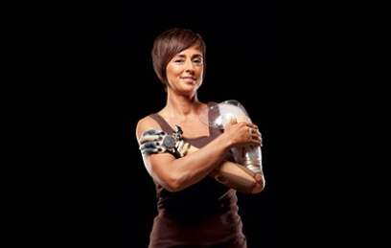
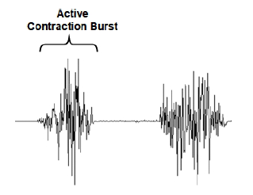
Design Problem: Helping Hand
Raw signal of muscle contraction measured on the skin:
  0.2 – 2 mV in amplitude
  Frequencies of interest are 5 - 1000 Hz. Lots of other sources of noise outside this frequency band.
Design a system that:
  Outputs ~ 2 -5 V amplitude when muscle contracts
  Contains frequency content (“potentially”) related to muscle contractions only.

Slide 27
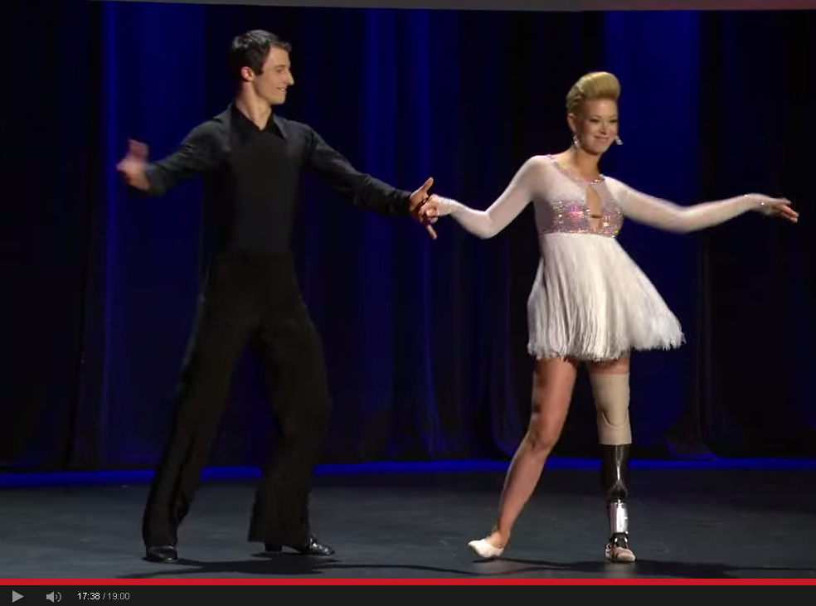
Neural Prosthetics in Real Life
Notes:
https://www.youtube.com/watch?v=CDsNZJTWw0w

Slide 28
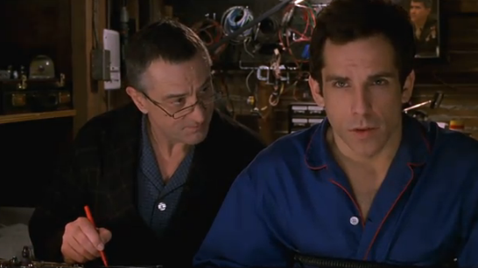
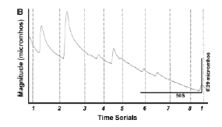
Meet the Parents: Lie Detector Circuit
Skin conductance vs. time

Slide 29
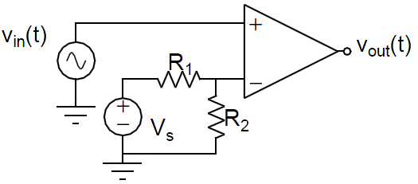
Given:
+/- V_{cc} = +/- 15 V
Vs = 5 V, R1 = 4 kΩ, R2 = 1 kΩ
Solve:
For the input signal shown below,
sketch v_{out}(t)
v_{in}(t) V
15
2
1
t (sec)
-1
-2
-15

Slide 30
Given:
+/- V_{cc} = +/- 15 V
Vs = 5 V, R1 = 4 kΩ, R2 = 1 kΩ
Solve:
For the input signal shown below,
sketch v_{out}(t)
v_{in}(t) V
15
2
1
t (sec)
-1
-2
-15
Comparator: v₋ = 1V. Pos. saturation occurs whenever v_{in}(t) > 1V, Neg. sat. otherwise

Slide 31
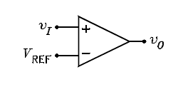
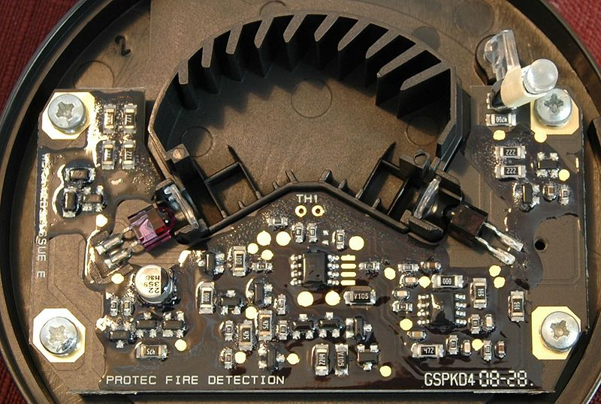
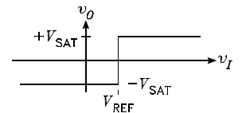
Comparator
Op amp in the smoke detector

Slide 32
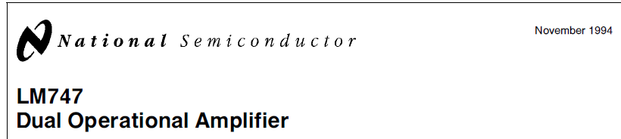
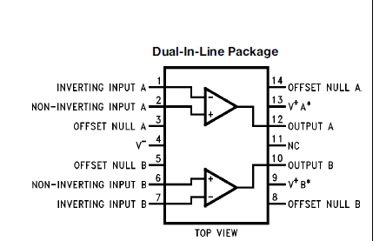
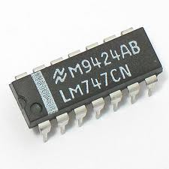
Data sheets

Slide 33
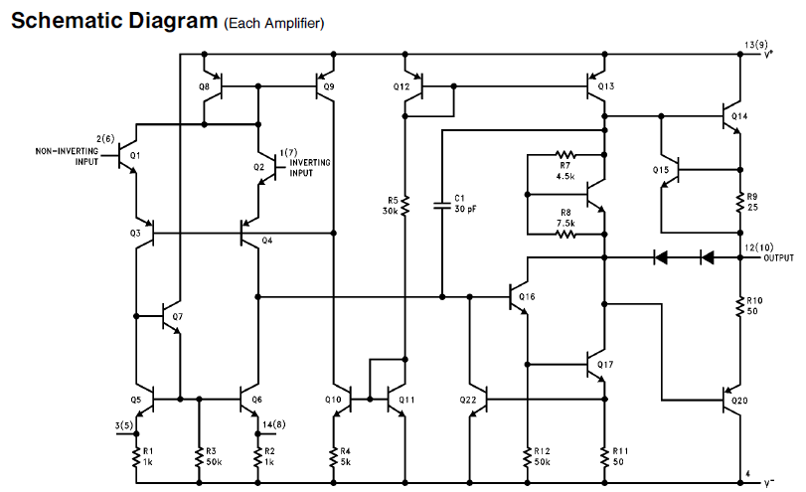
What’s in the box: Lots of transistors

Slide 34
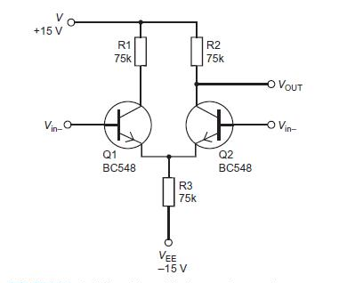
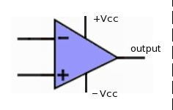
Differential Amplifier
I₂
I₁
V_{out} = A(V_{in+} - V_{in-})
A ~ 10I_{T}R₂
A is the “open loop” voltage gain
V_{in+}
I_{T}
Image credit: http://www.electronic-basics.com/2011/10/differential-amplifier.html

